Slide 1
System Block Diagram
Battery monitoring
Washer fluid tank
Rain sensor
CAN I/P
PIC18F458 Controller
L1
Warning Lamp
Wiper inputs
(Switches)
S1
L2
Front Wiper
S2
L3
Rear Wiper
CAN O/P
Hardware warning lamp status
Washer output control
Headlight washer

Slide 2

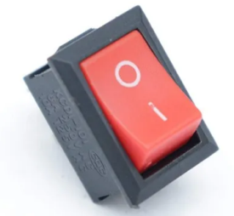
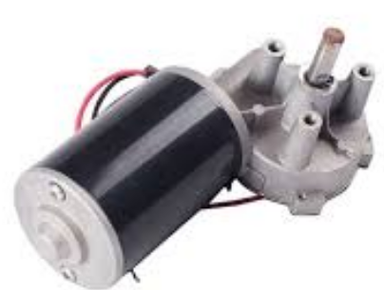


Hardware block diagram
INPUT
Warning lamp
Microcontroller
Switch 1
Motor
Switch 2
FRONT WIPER
REAR WIPER
OUTPUT
INPUT
Intermediate Wires
LED 2
LED 3
OUTPUT

Slide 3
Functional Block Diagram
switches()
SW1,SW2
CAN_INIT
Clearing TRISBbits,Enabling Periferals &Switches
SYS_INIT
GIE
PEIE
s
Main Function
Sys_init()
CAN_init()
CAN_TX()
CAN_RX()
Warning LED()
Wiper()
Washer()
Wiper()
Front & Rear Wiper Control
Warning LED
LED1 is on until msg is passed LED2 &LED3 is ON for front & rear wiper respectively
Washer()
Used using CAN messages
CAN_TX
CANCON
TXB1SIDH
TXB1DLC
TXB1CON
CAN_RX
CANCON
TXB1SIDH
TXB1DLC
TXB1CON

Slide 4
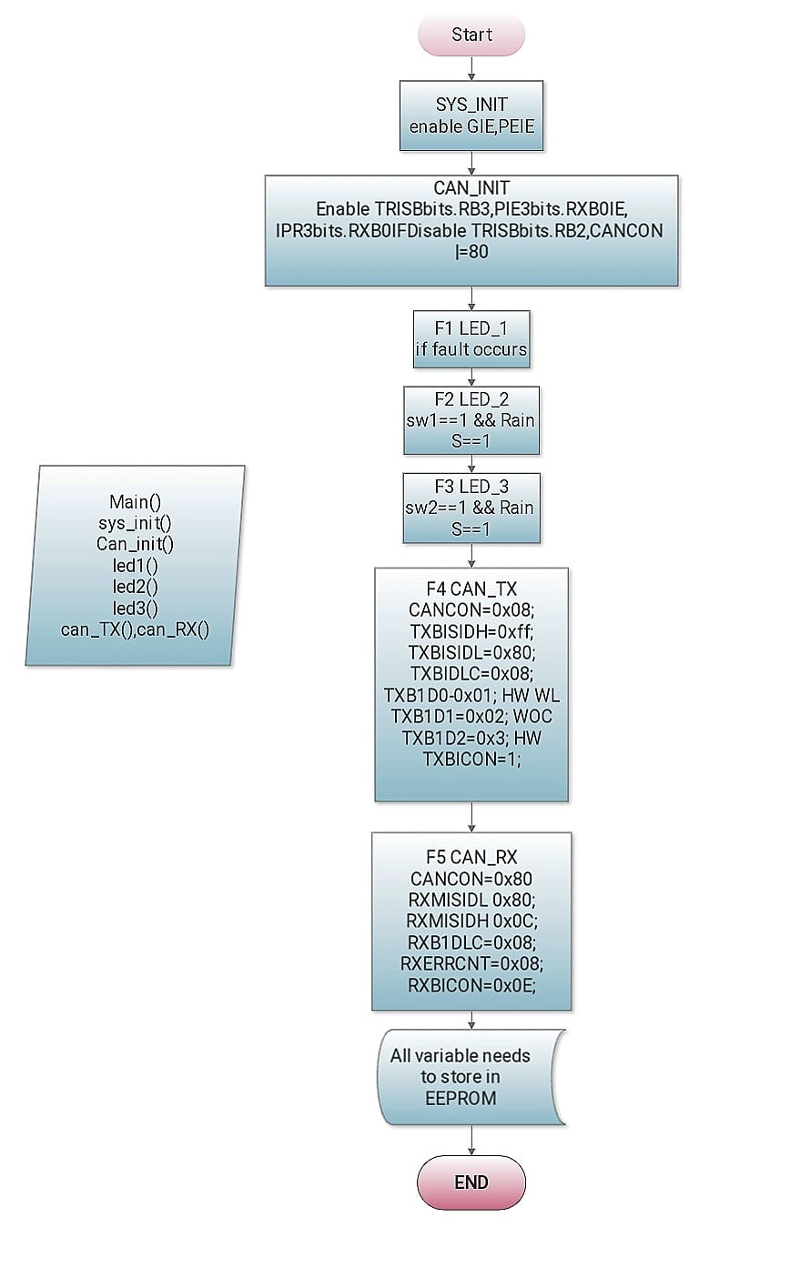
Sequential Block diagram

